Slide 1
Predicting Major League Baseball (MLB) Player Salaries
Jeff Hoffman

Slide 2
Introduction

Slide 3
Introduction
Goal: Build a model using XGBoost to predict Major League Baseball (MLB) player salaries.
Purpose: Determine player value and provide insights on what drives value creation.
Application: Salary negotiations, team budgets, overpaid/underpaid players
Client: MLB teams and their organizations, fantasy baseball

Slide 4
II. Data

Slide 5
Data
http://www.seanlahman.com/baseball-archive/statistics/
Batting data
Salary data
All Star data
Pitching data
https://www.bls.gov/cpi/
Consumer Price Index (CPI) data

Slide 6
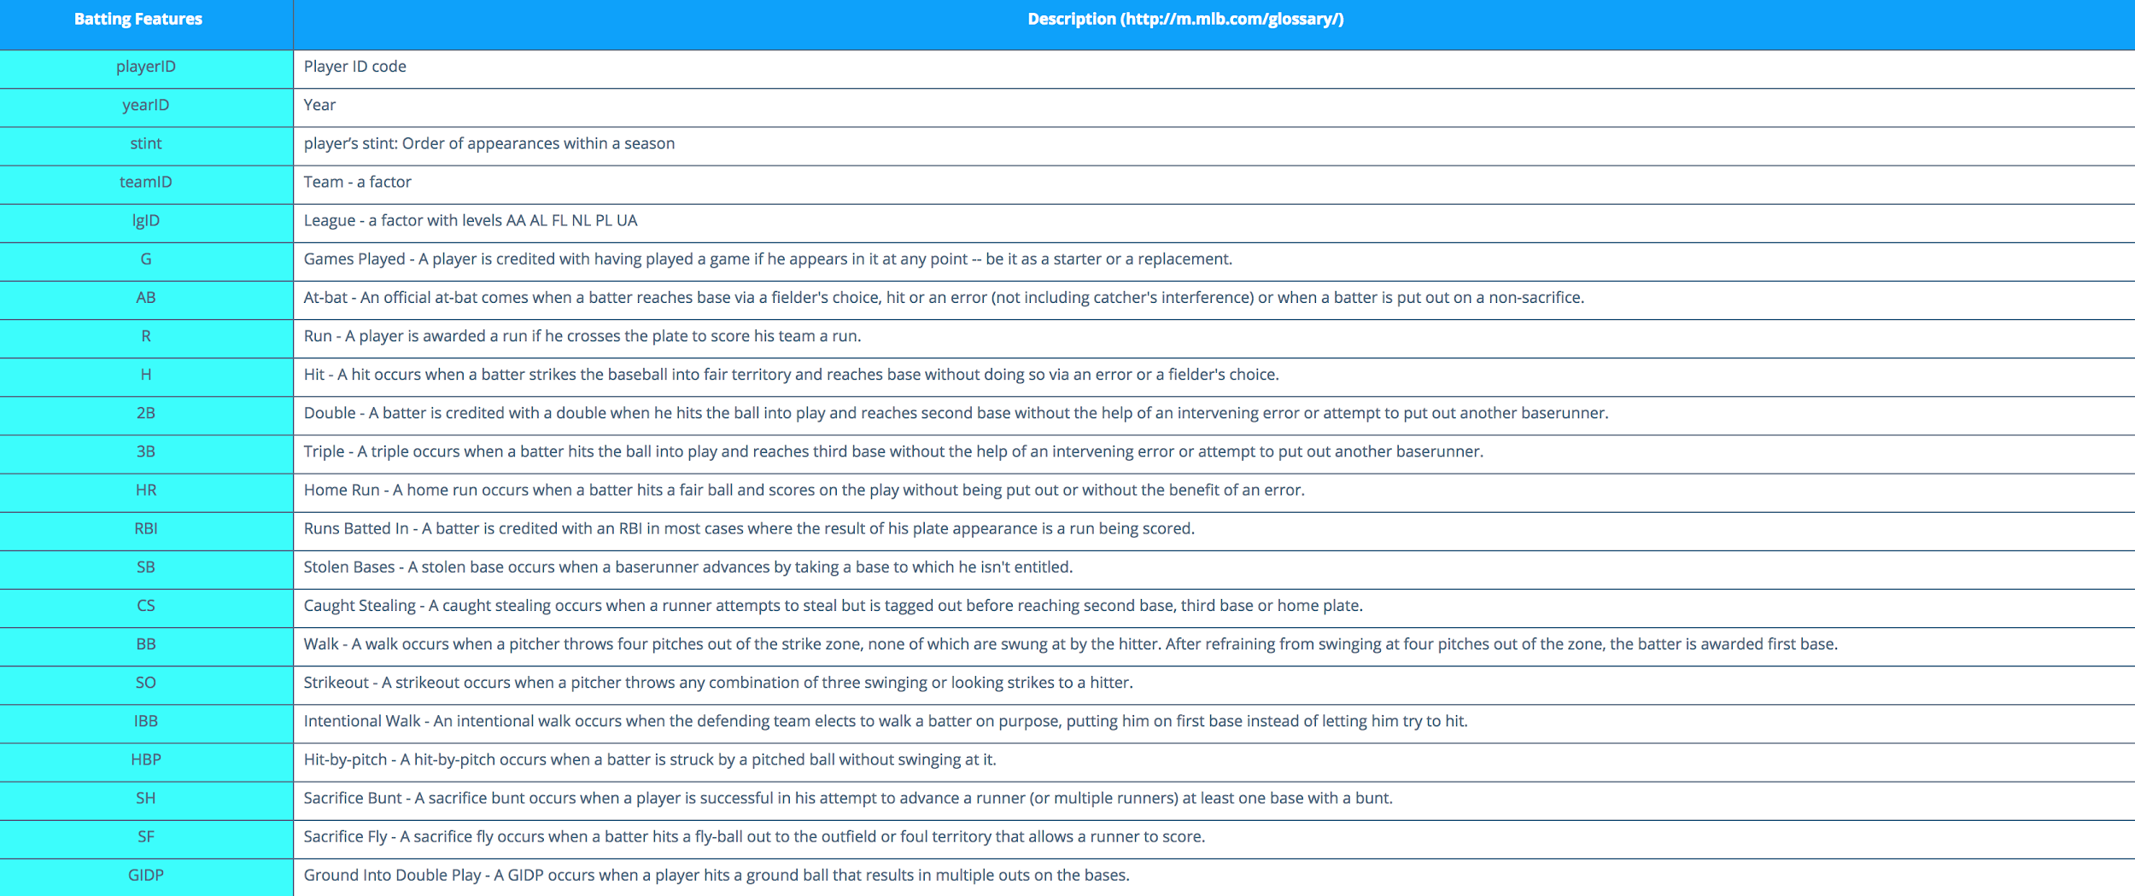

Slide 7
III. Data Wrangling

Slide 8
Data Wrangling
Step 1: Remove the pitchers from the batting data.
Step 2: Remove all years before 1985 from the batting data.
Step 3: Merge the batting data with the salary data.
Step 4: Remove data where salary is below the set minimum salary in 1985.
Step 5: Add Experience and All Star features.
Step 6: Adjust salary for inflation.

Slide 9
IV. Exploratory Data Analysis

Slide 10
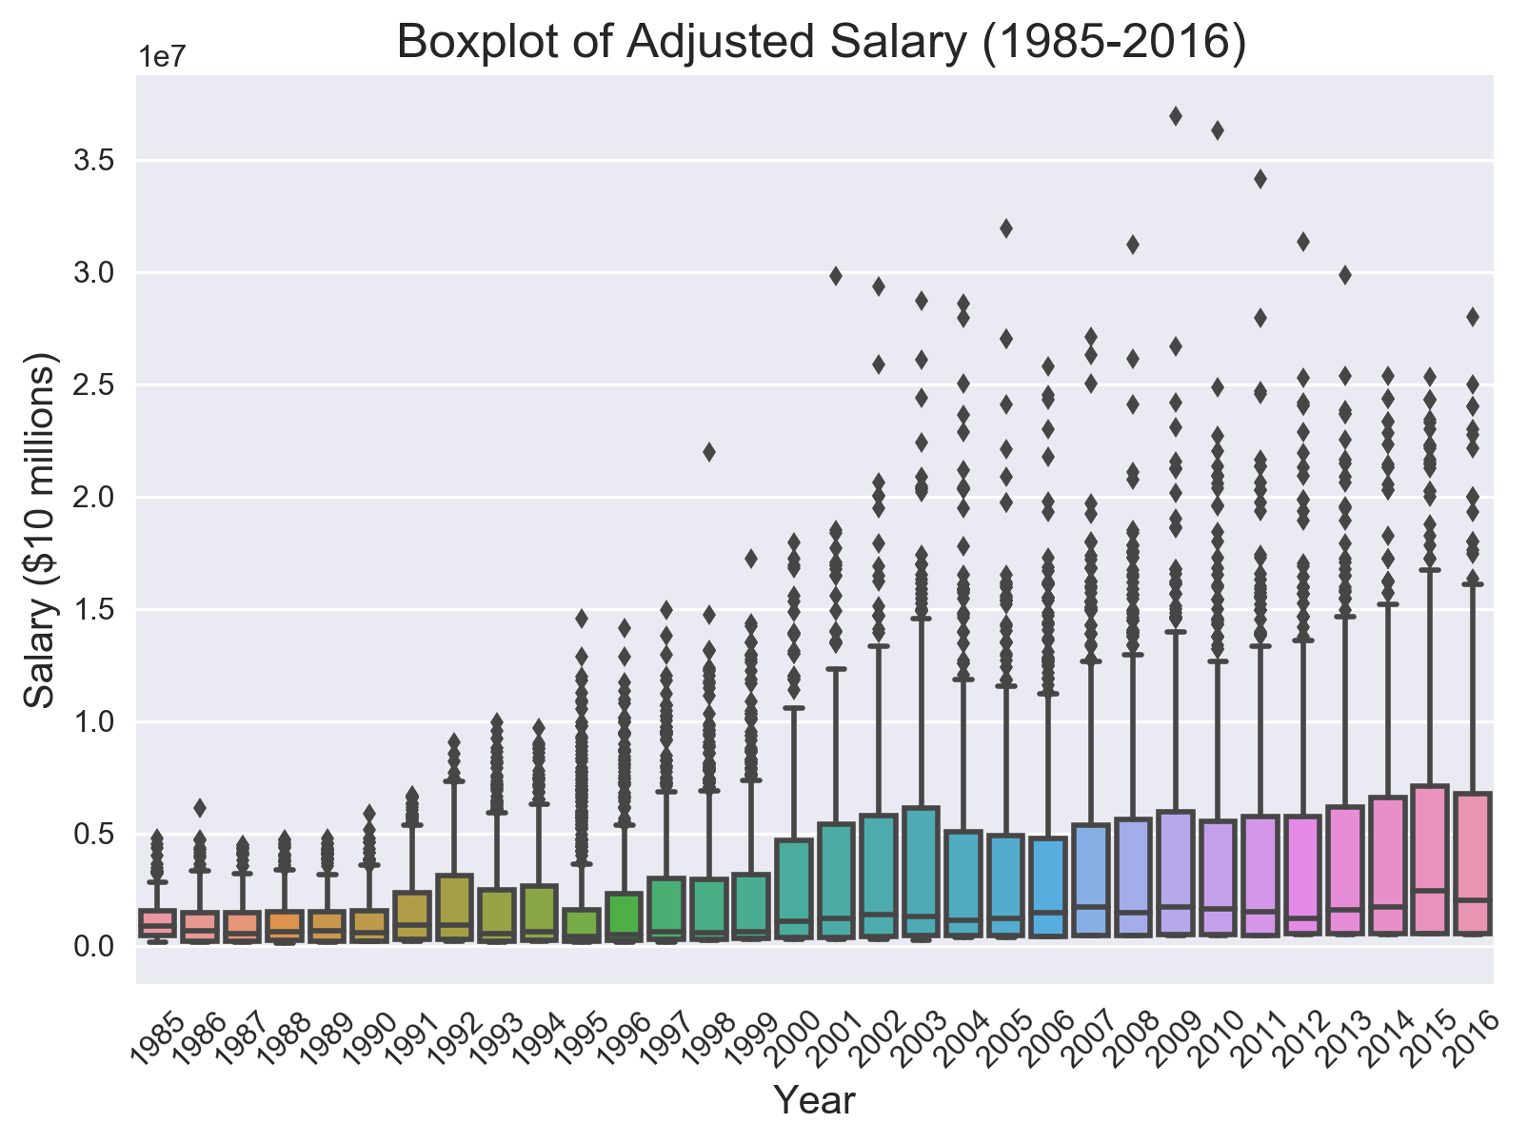

Slide 11
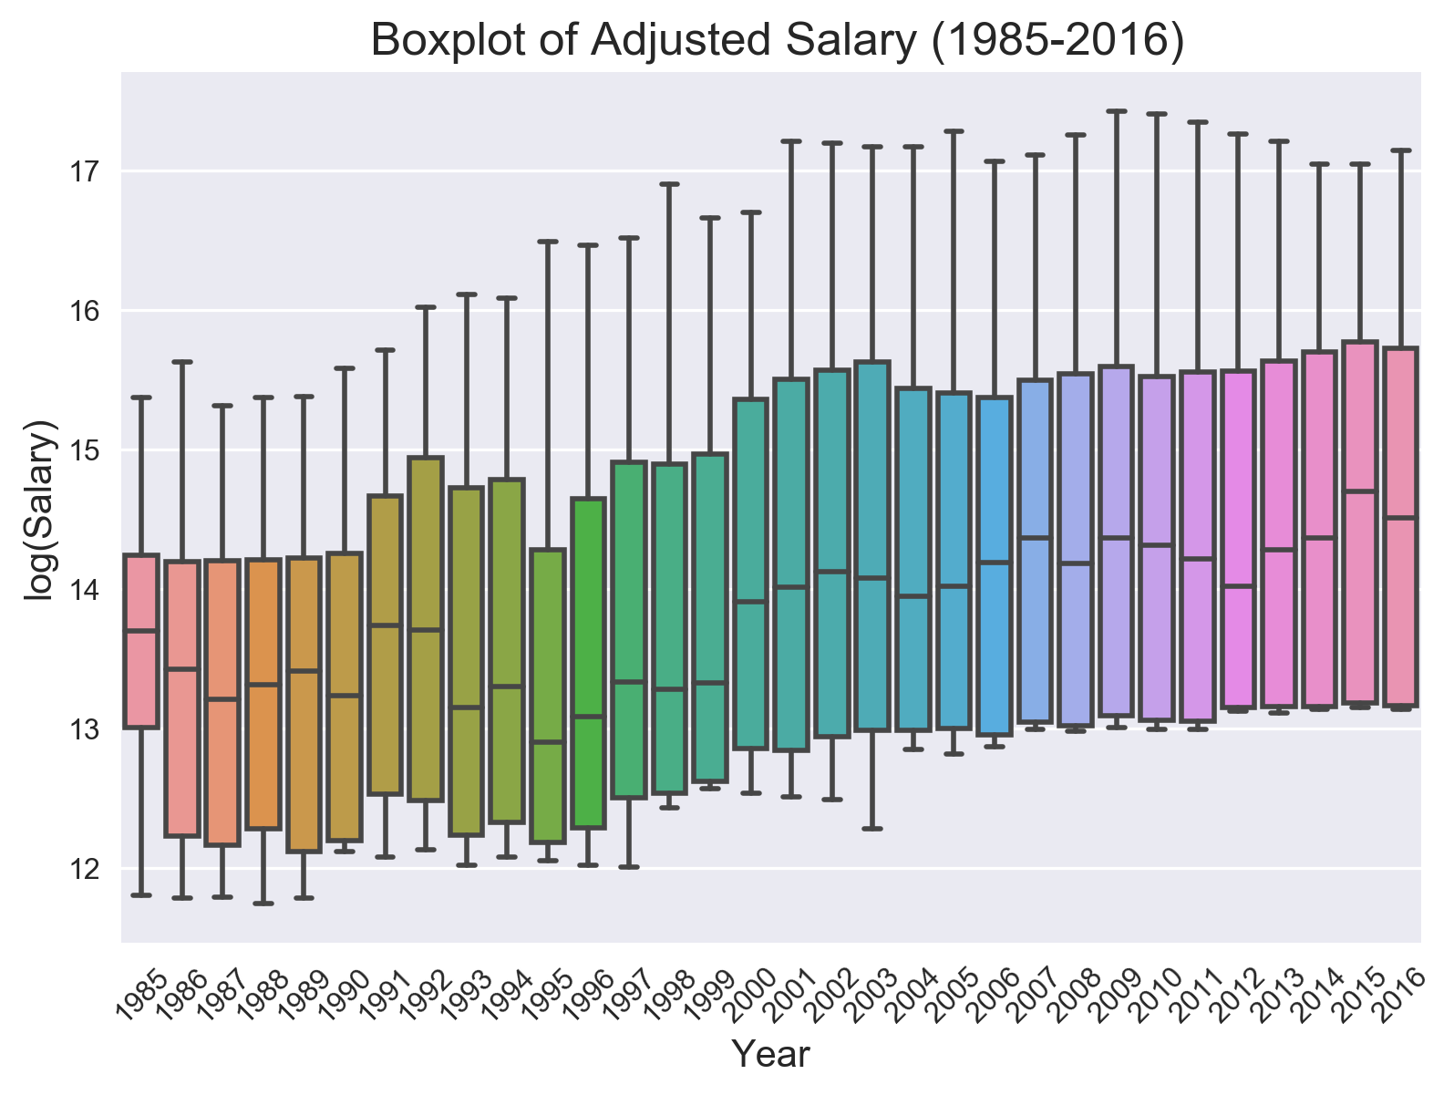

Slide 12
Let’s look at some plots between salary and what the MLB calls “standard stats”:
batting average (AVG)
home runs (HR)
runs batted in (RBI)
runs (R)
stolen bases (SB)

Slide 13
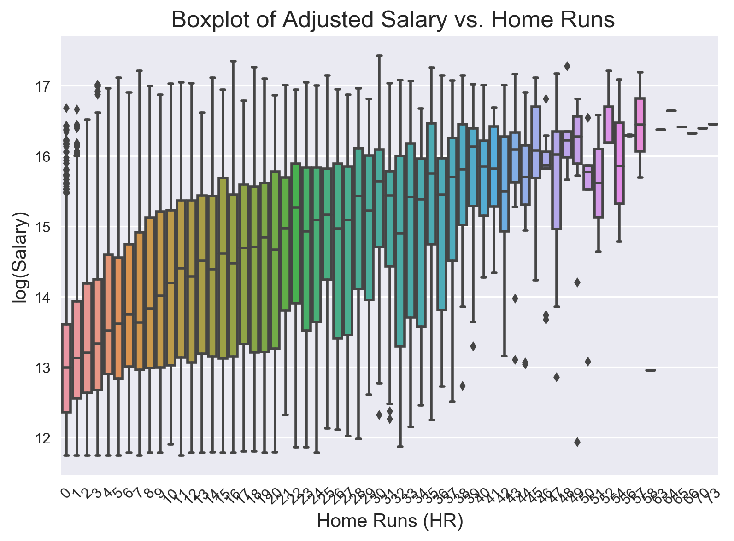

Slide 14
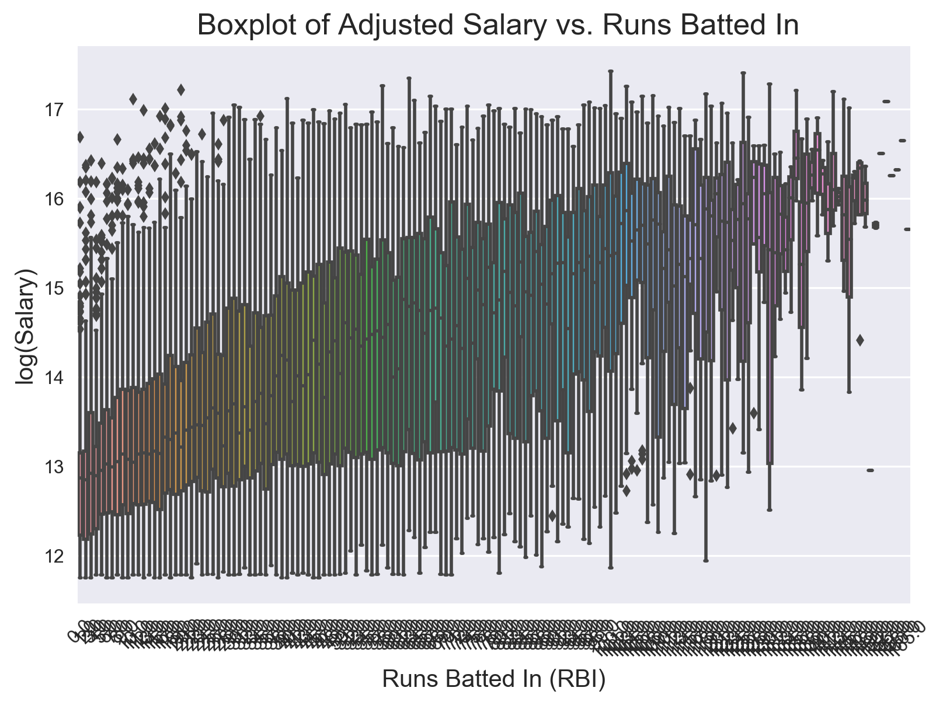

Slide 15
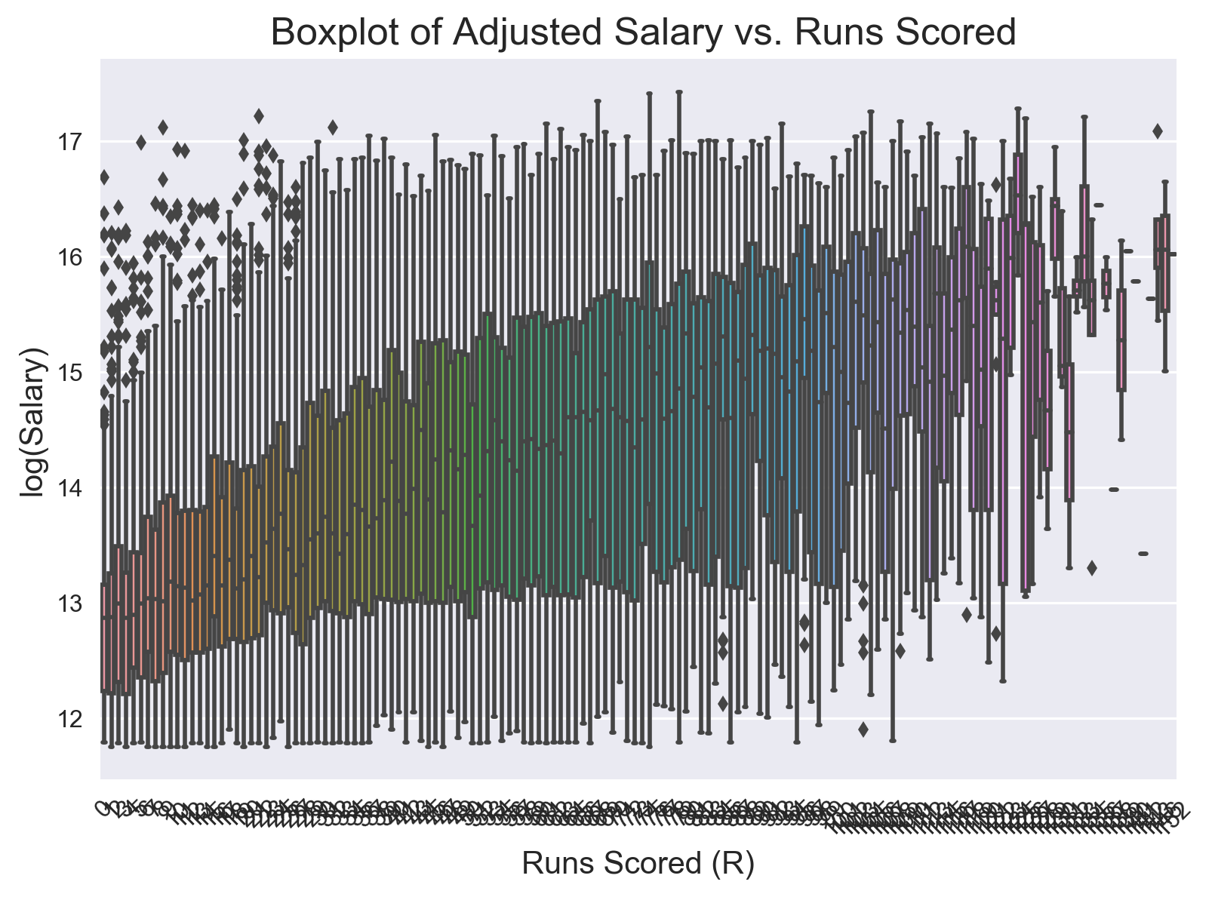

Slide 16
...and how each of the features relate to each other and the target variable.

Slide 17
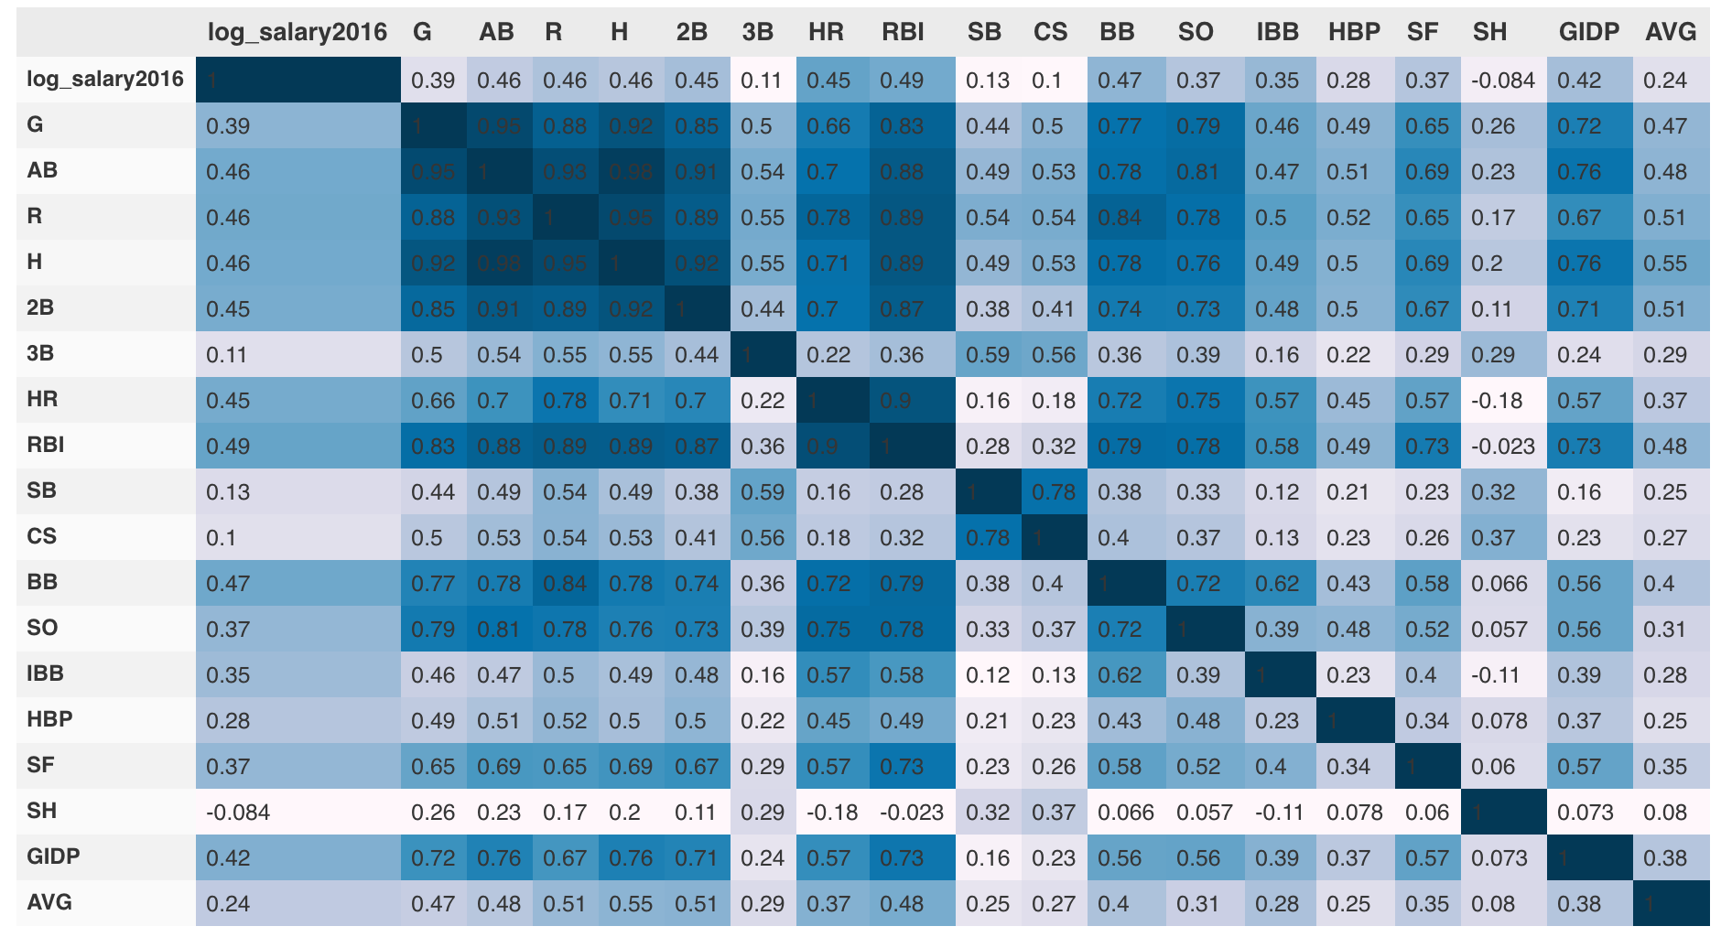

Slide 18
Let’s look at the salary profile of the top 50 and top 100 highest paid MLB players.

Slide 19
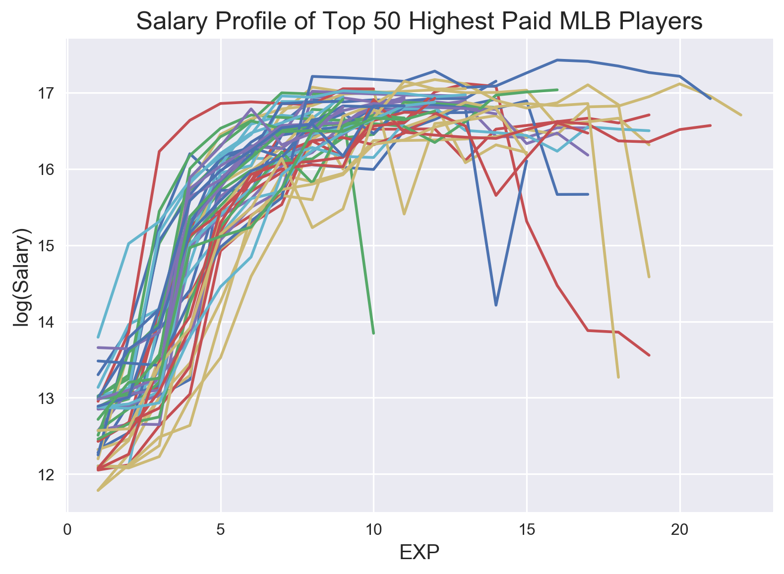

Slide 20
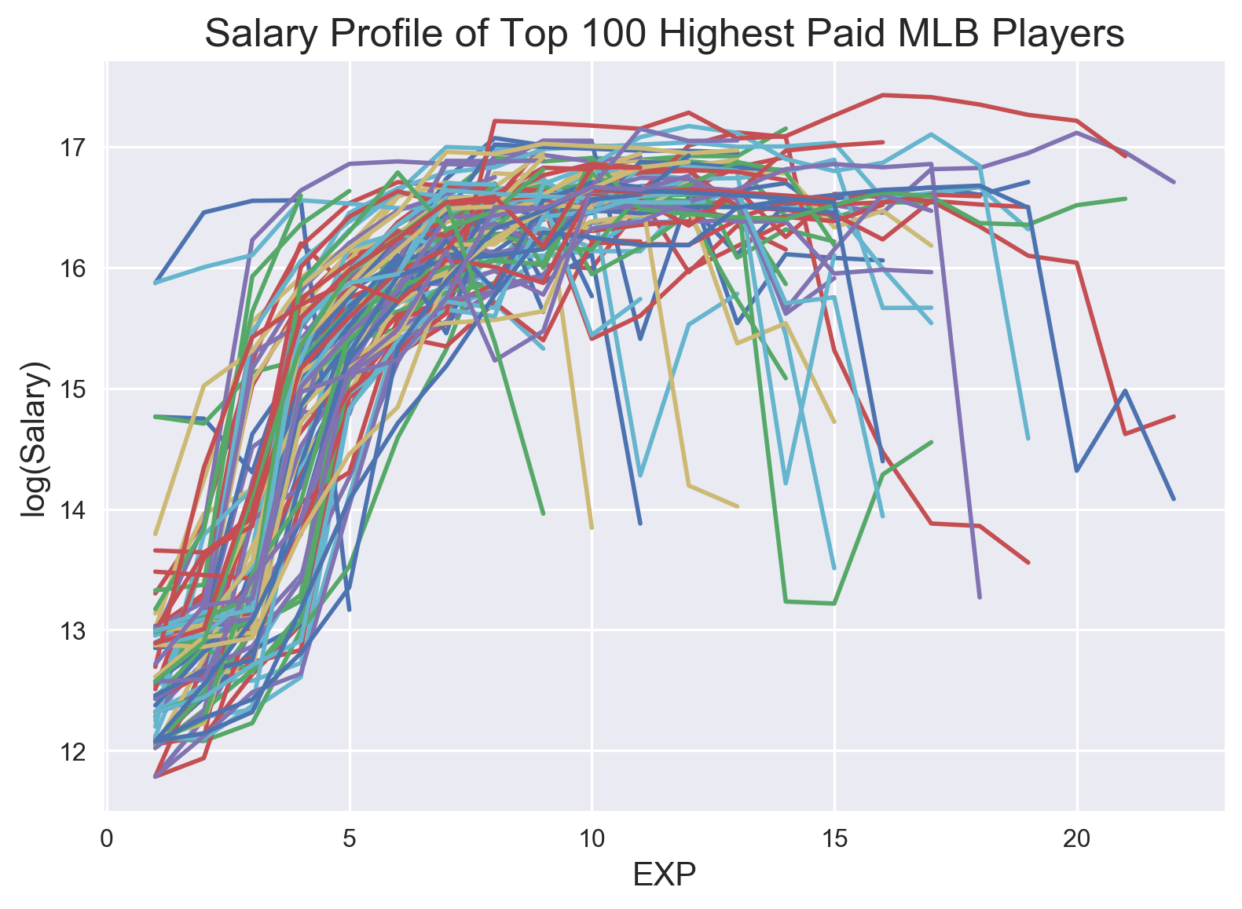

Slide 21
Notice the nonlinearity of the salary profile. Let’s take a look at the boxplot.

Slide 22
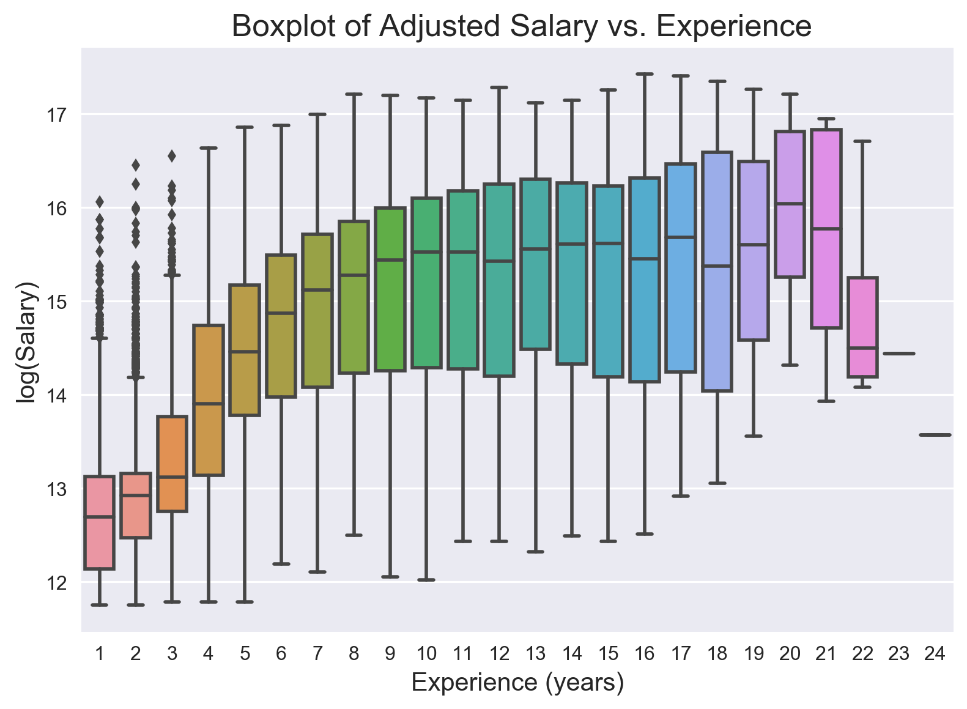

Slide 23
V. Feature Engineering

Slide 24
Feature Engineering
Quadratic term for experience (EXP-squared).
Lags of the target and feature variables.
On base percentage (OBP) - a measure of how often a batter reaches base.
Interactions between features - EXP with OBP, HR with OBP.

Slide 25
VI. Models and Results

Slide 26
Linear Regression Models

Slide 27
45%
Of the total variation in salary is explained by only using the feature variables given to us, lagged one year.

Slide 28
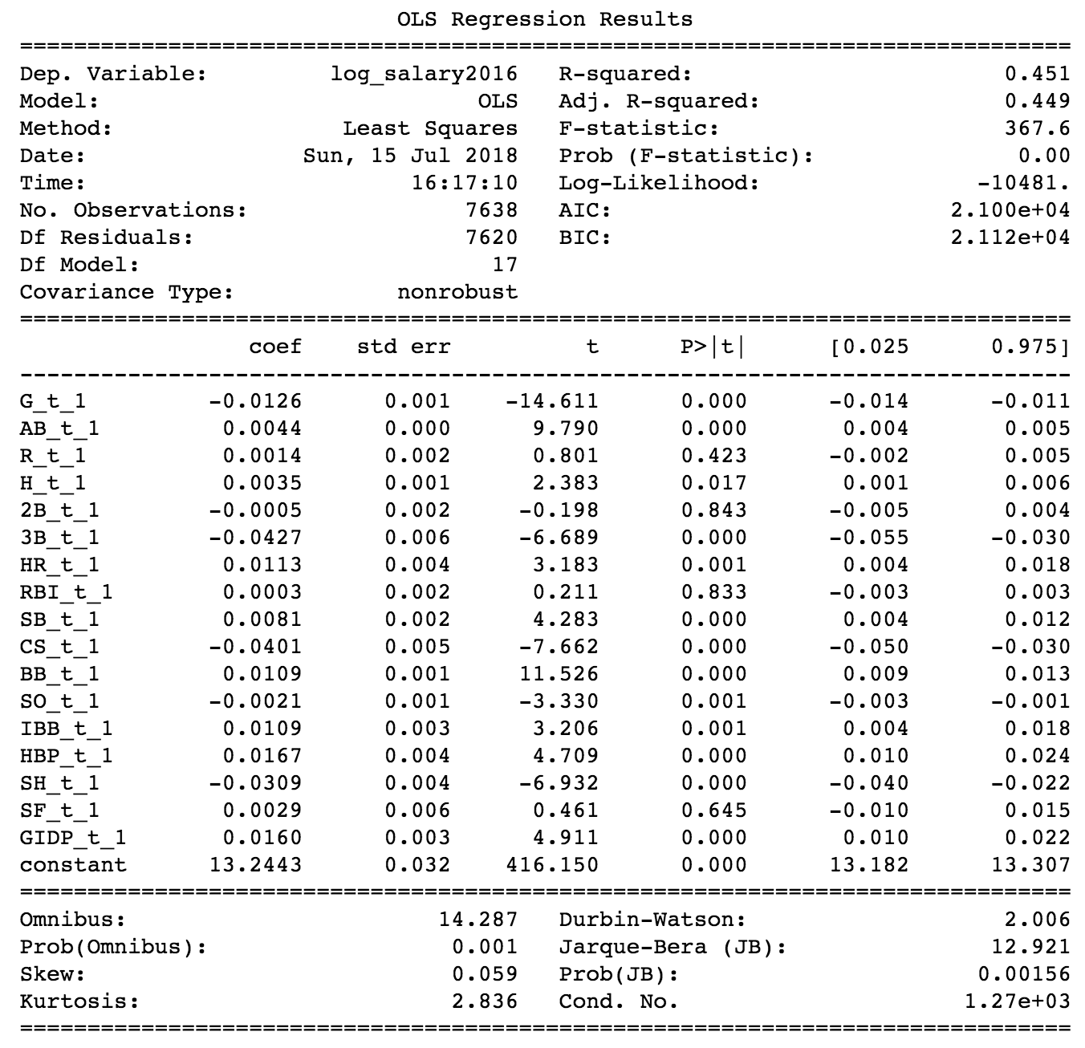
Baseline OLS
“Lazy” model
Just lag what you are given by one year.

Slide 29
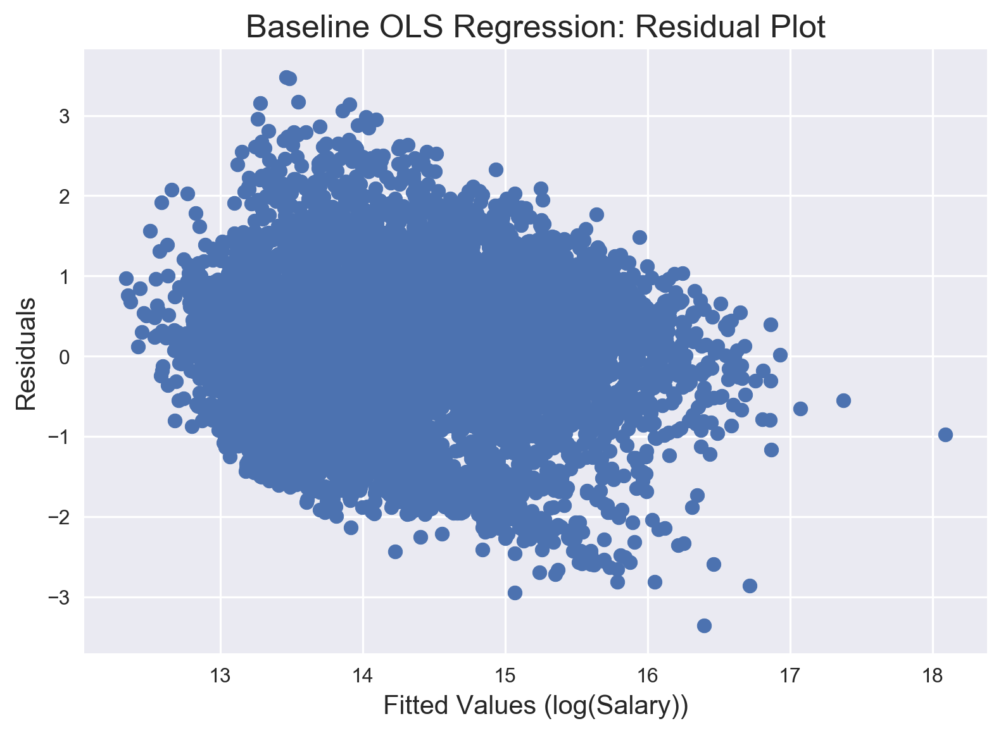

Slide 30
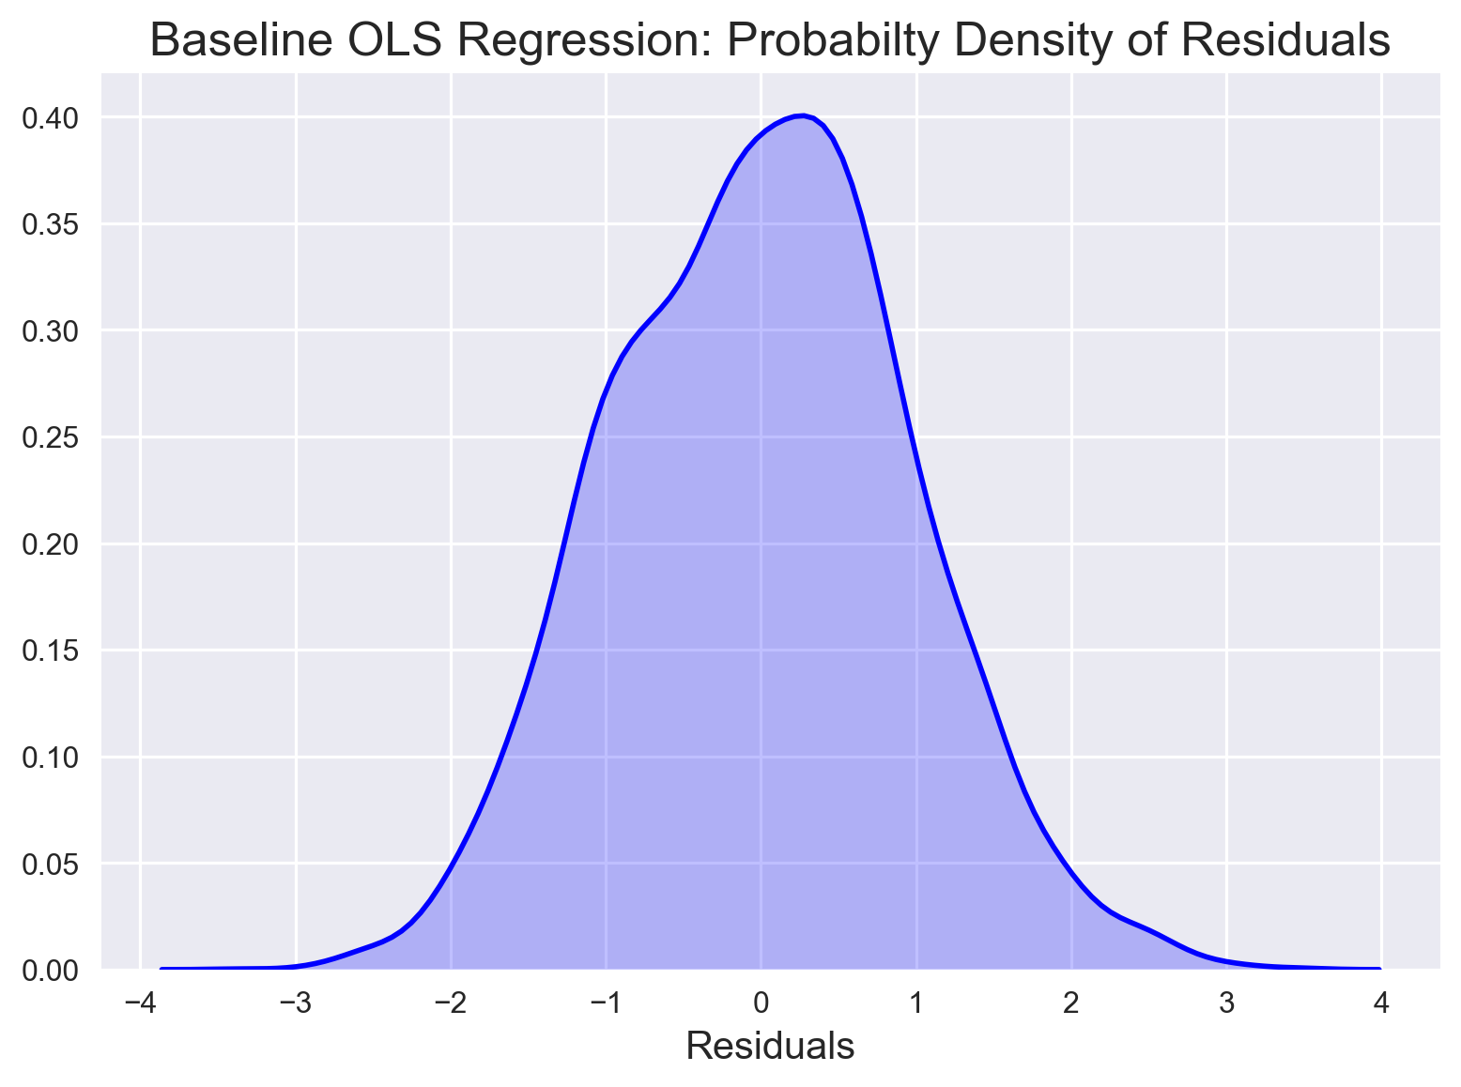

Slide 31
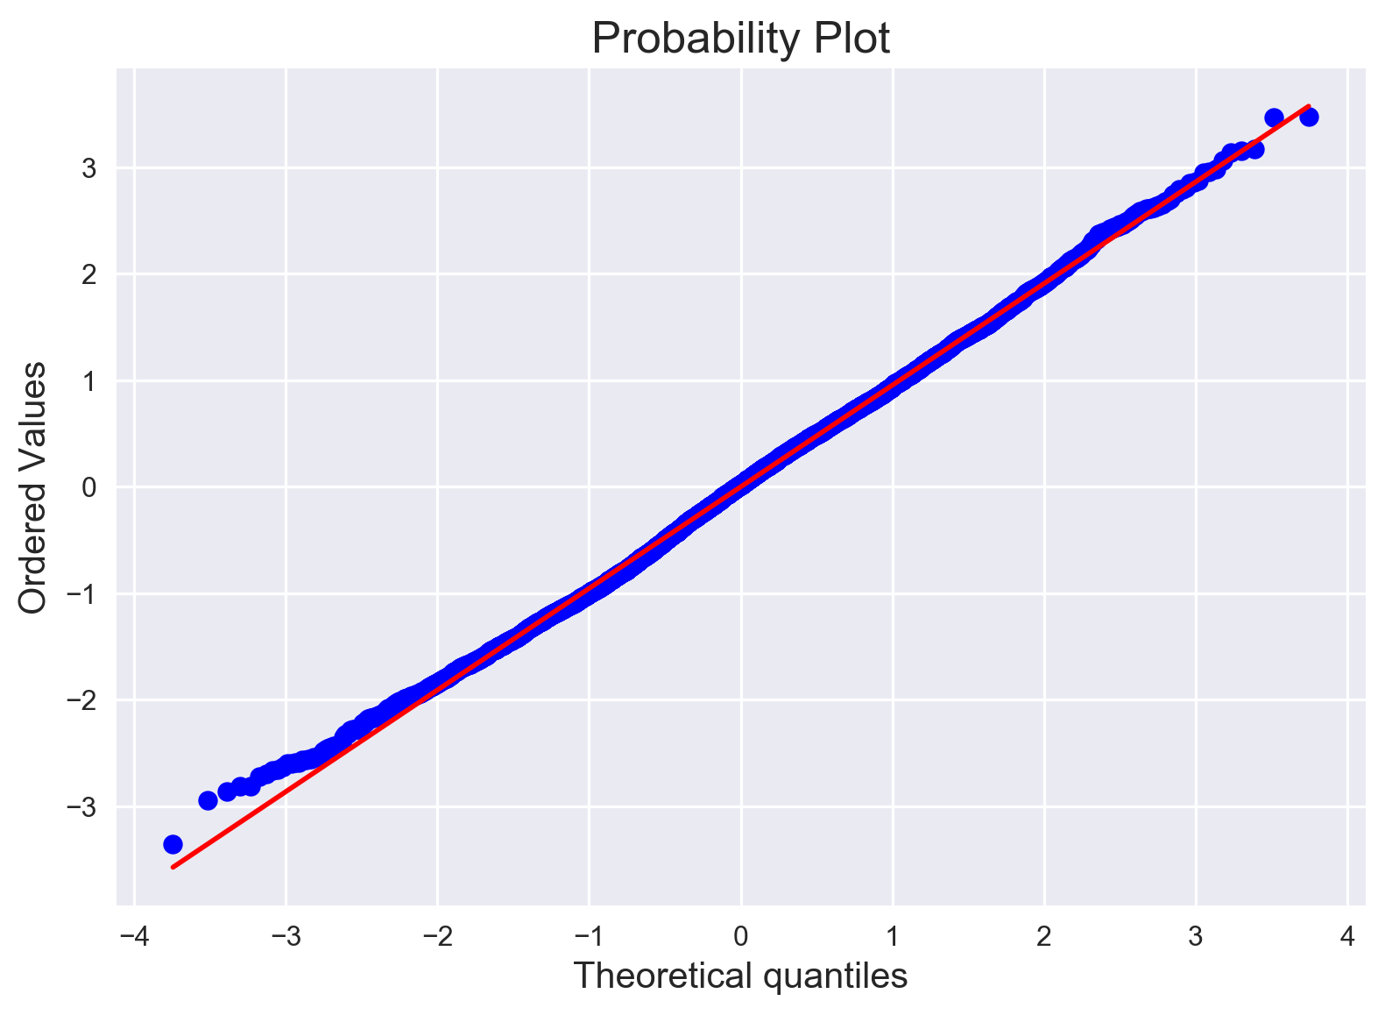

Slide 32
79%
Of the total variation in salary is explained by adding in the engineered features, lagged one year.

Slide 33
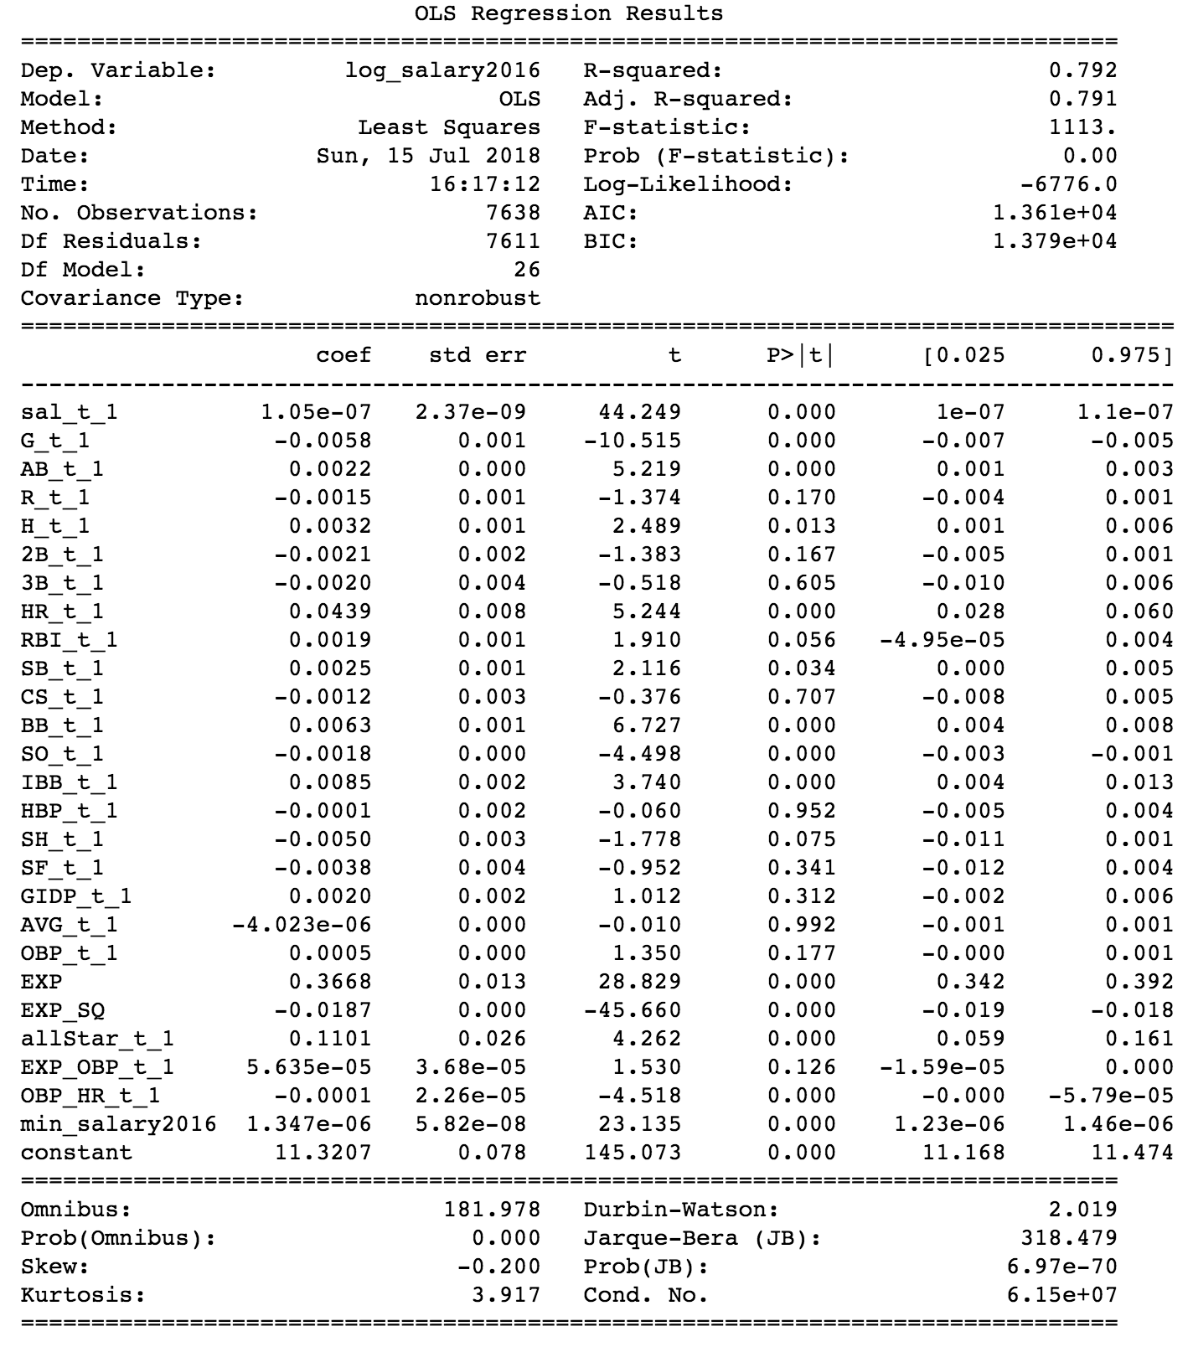
Feature Engineered OLS
Much better!

Slide 34
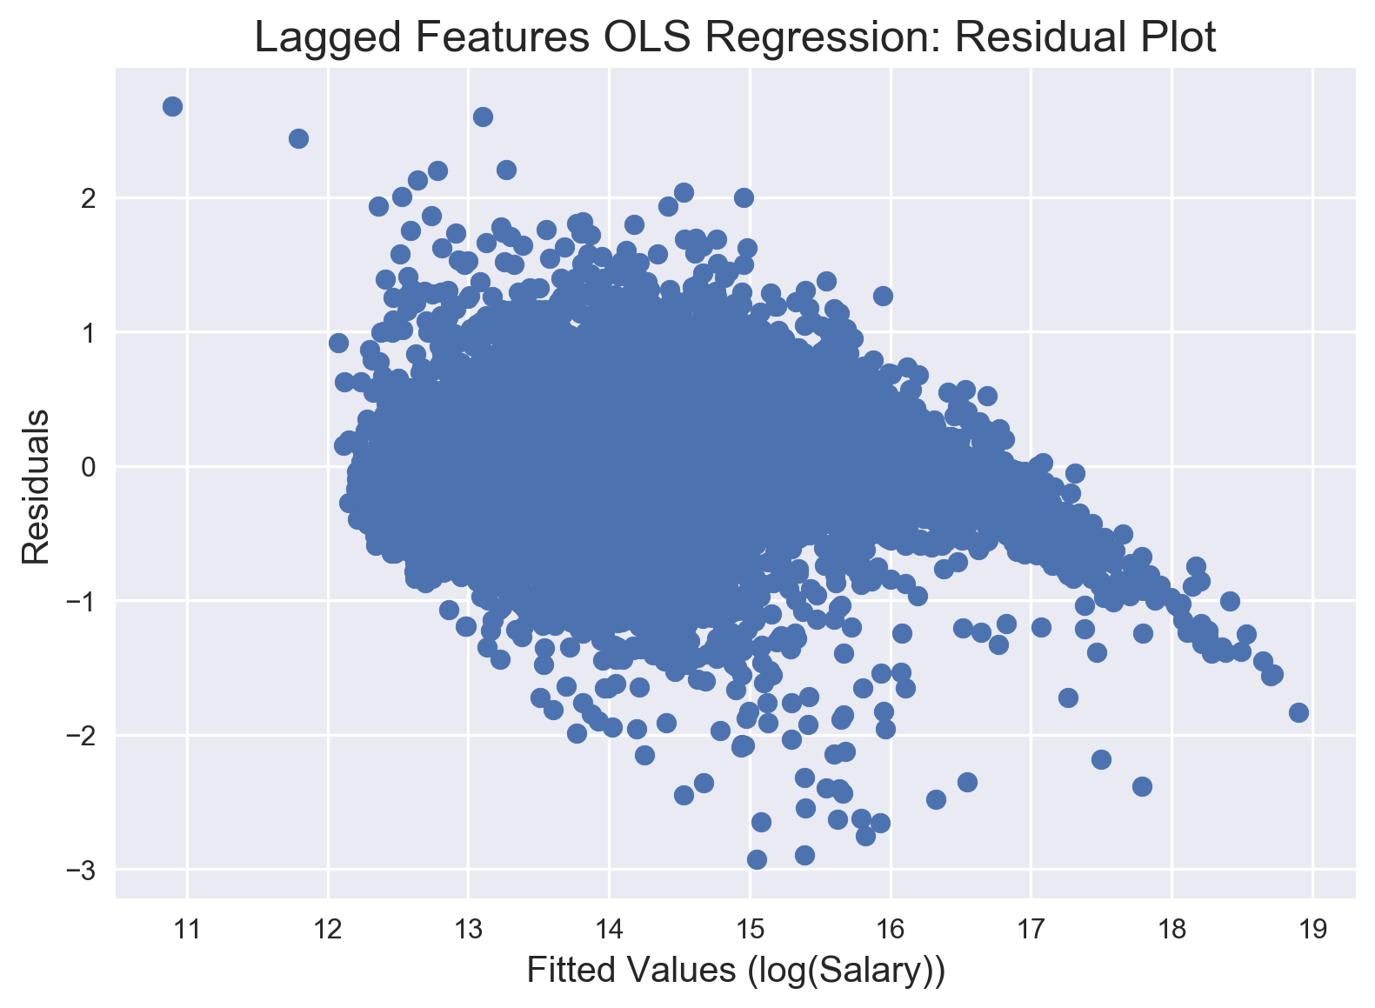

Slide 35
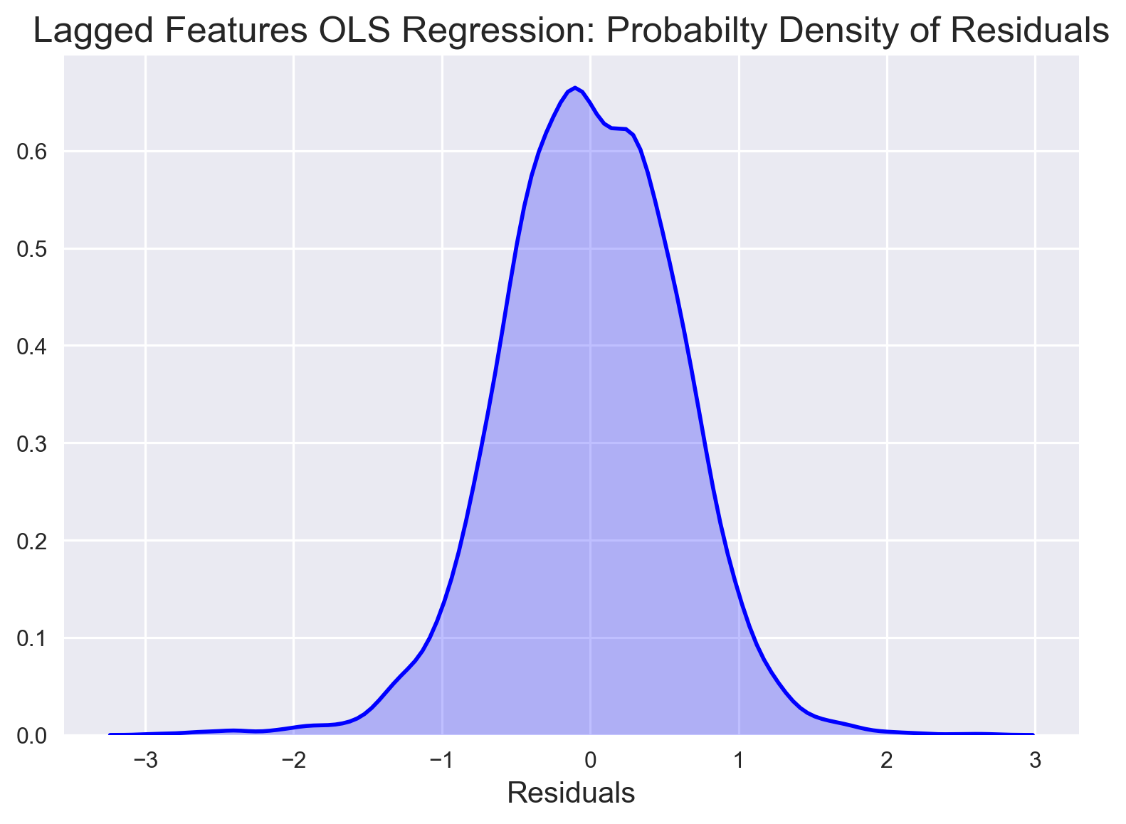

Slide 36
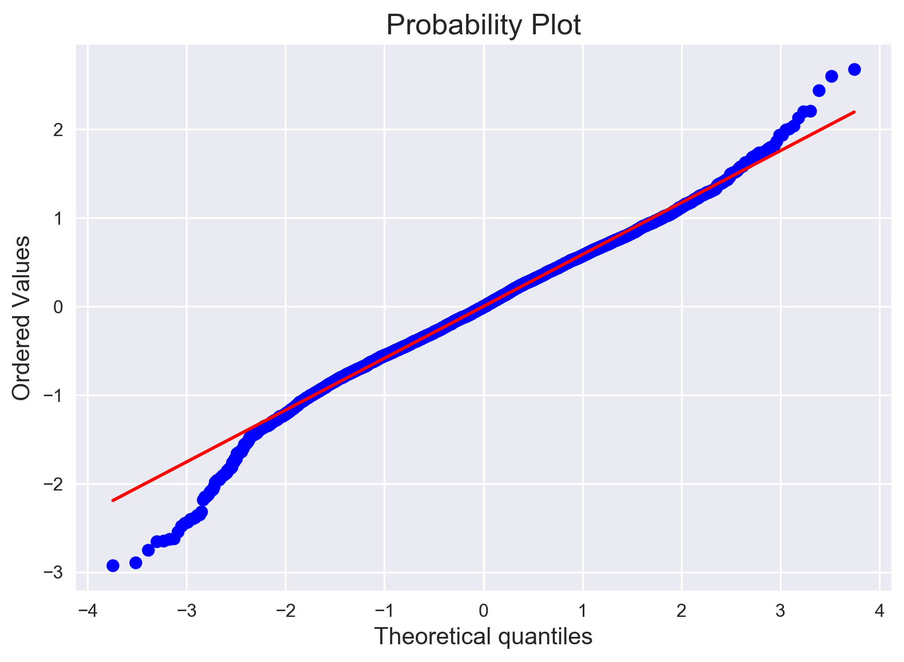

Slide 37
XGBoost Models

Slide 38
89%
Of the total variation in salary is explained by using the engineered features, lagged one year.

Slide 39
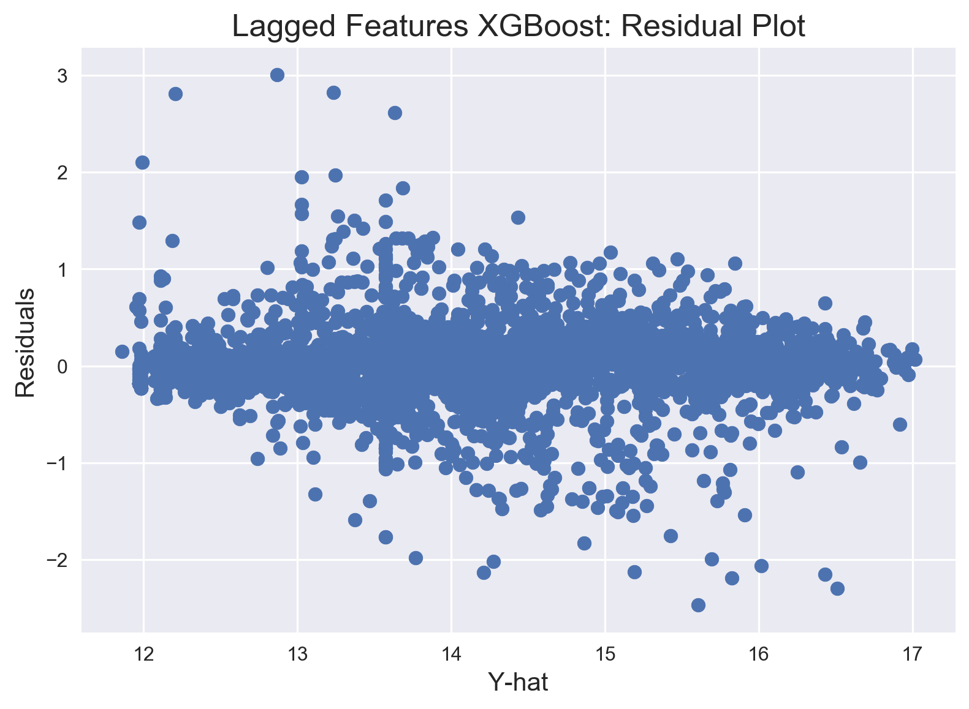

Slide 40
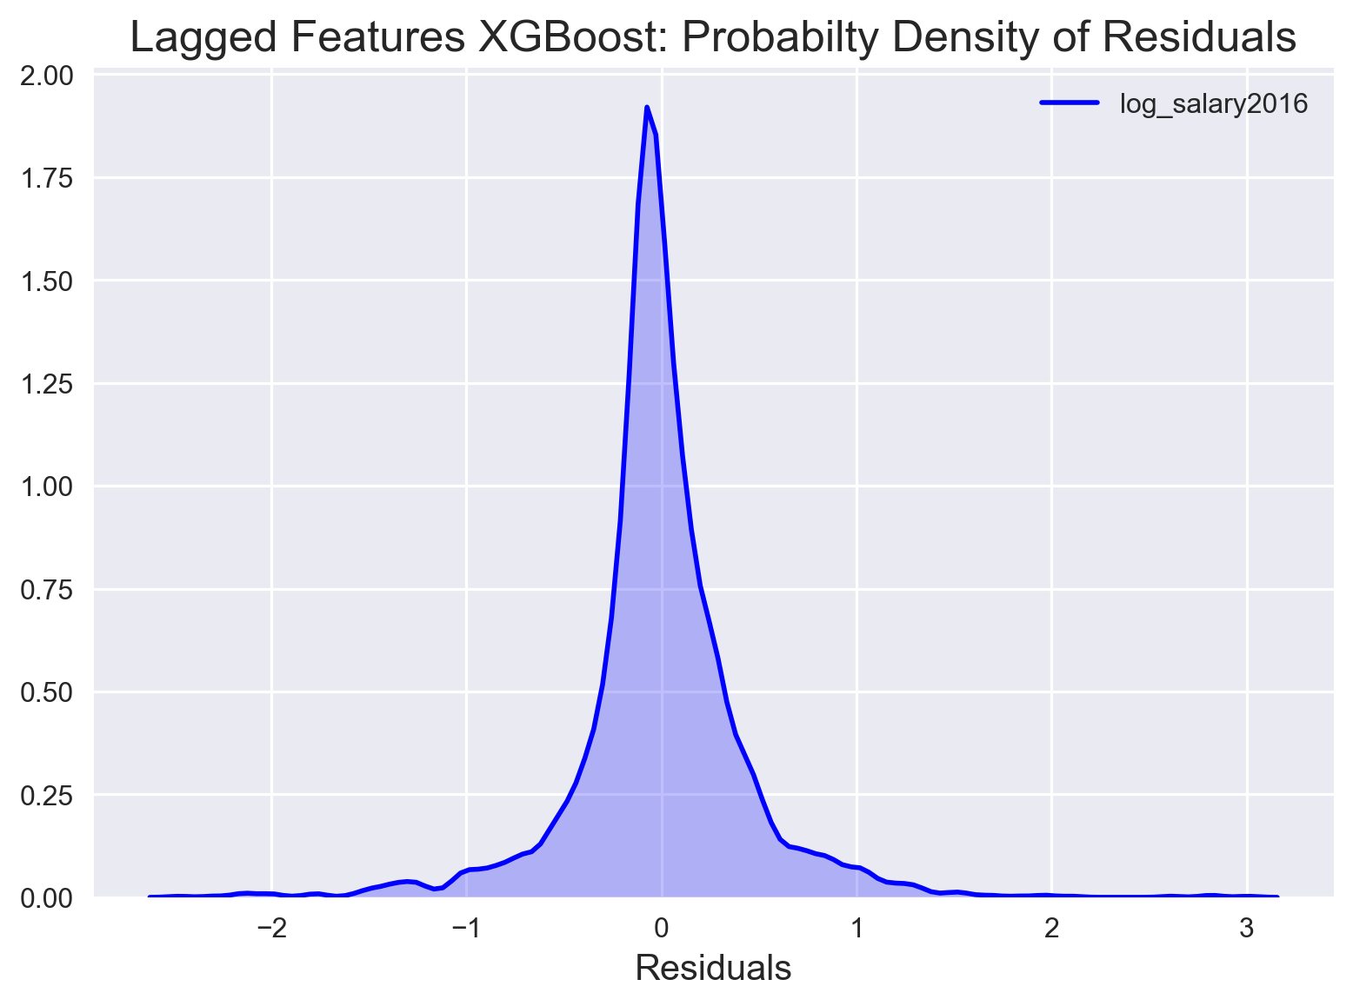

Slide 41
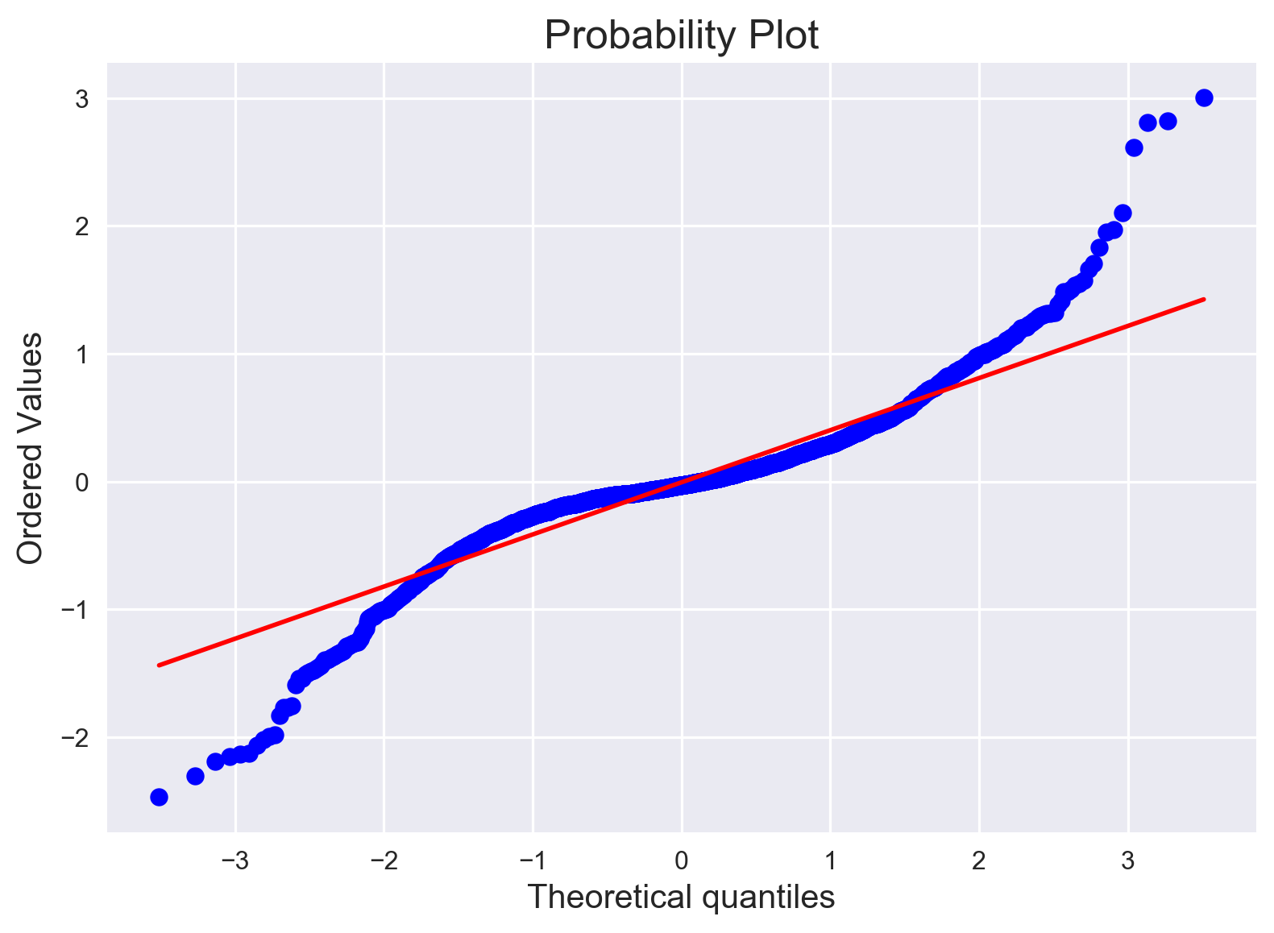

Slide 42
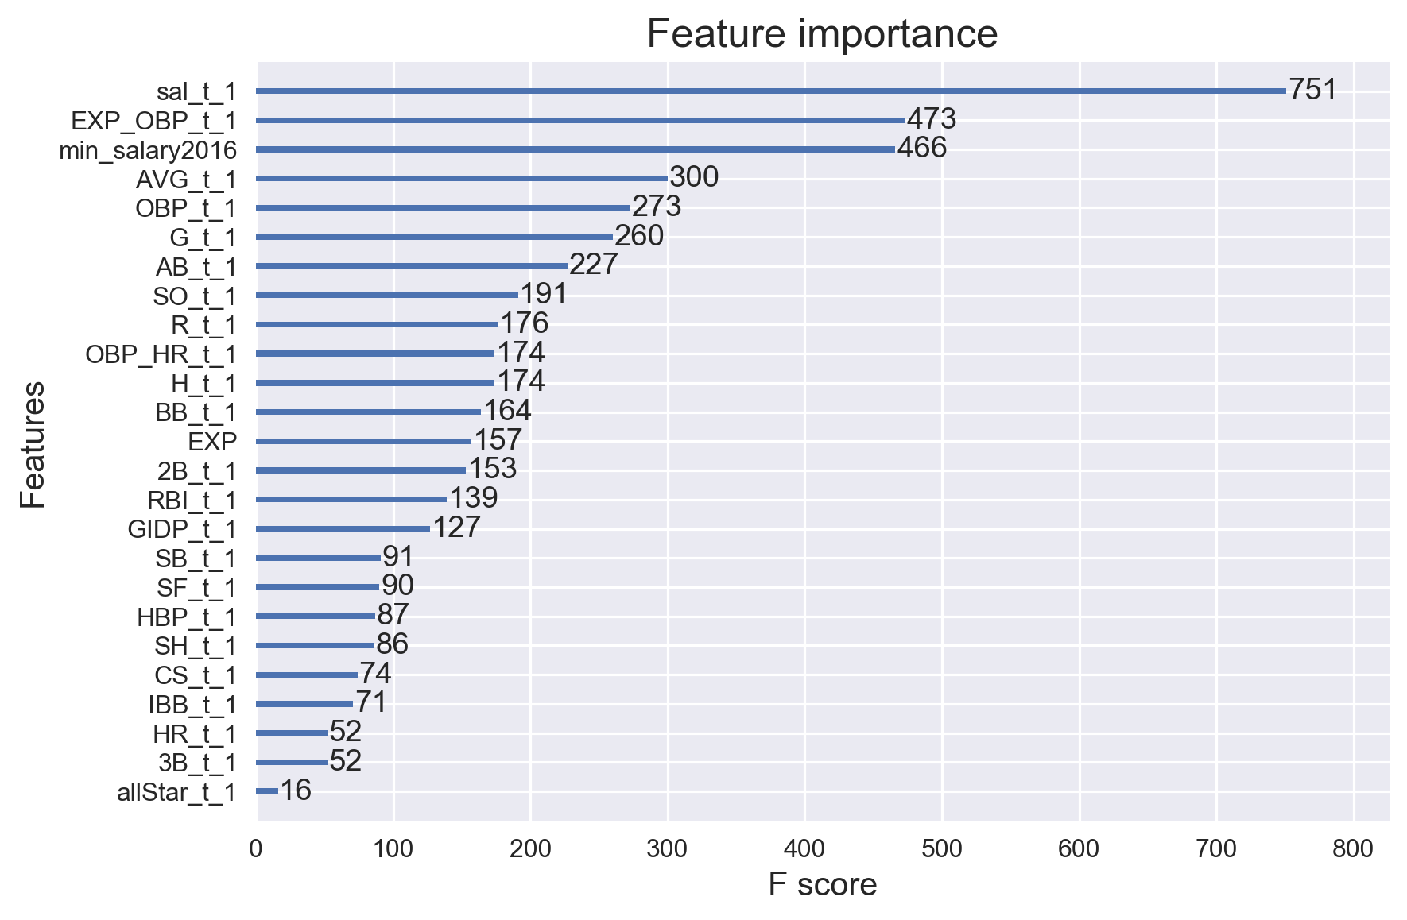

Slide 43
Now let's use the feature importance graph from above to try and increase our model performance. Let's try removing all the features that have a F score of less than 100. Let's also add in two-year lags for the features that have an F score of above 100. Let's see if this makes any difference in our model performance.

Slide 44
90%
Of the total variation in salary is explained by the adjusted XGBoost model.

Slide 45
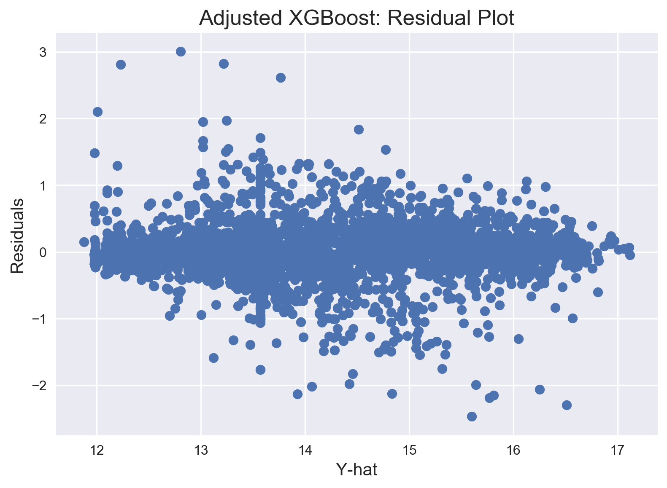

Slide 46
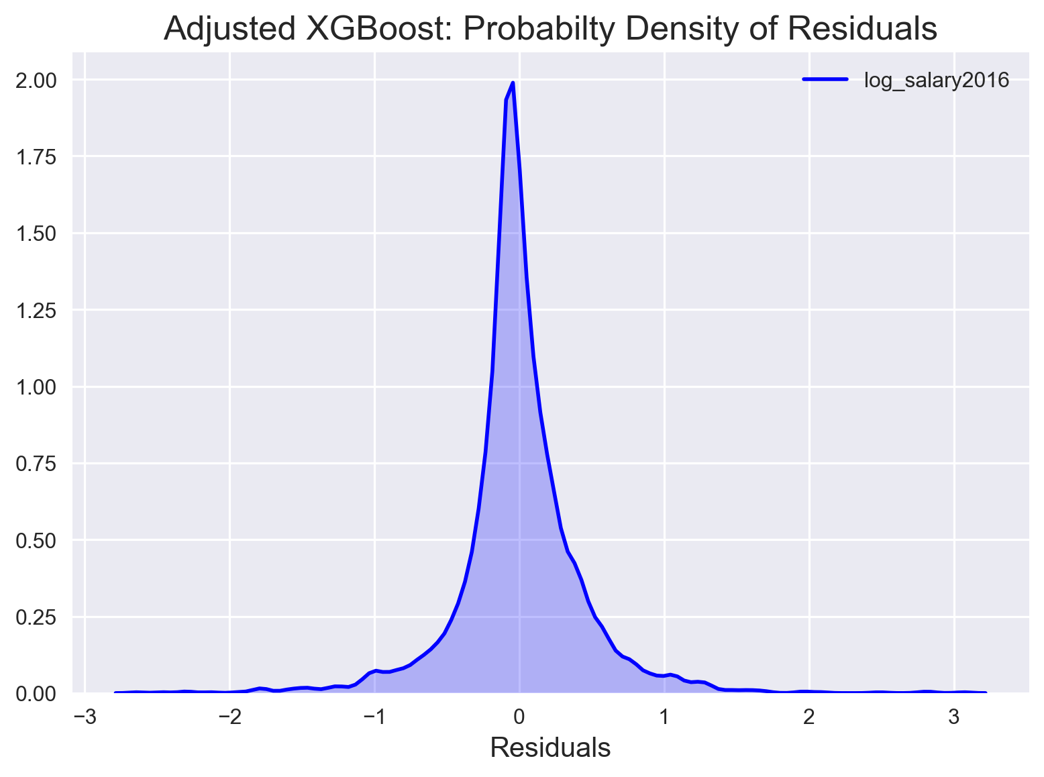

Slide 47
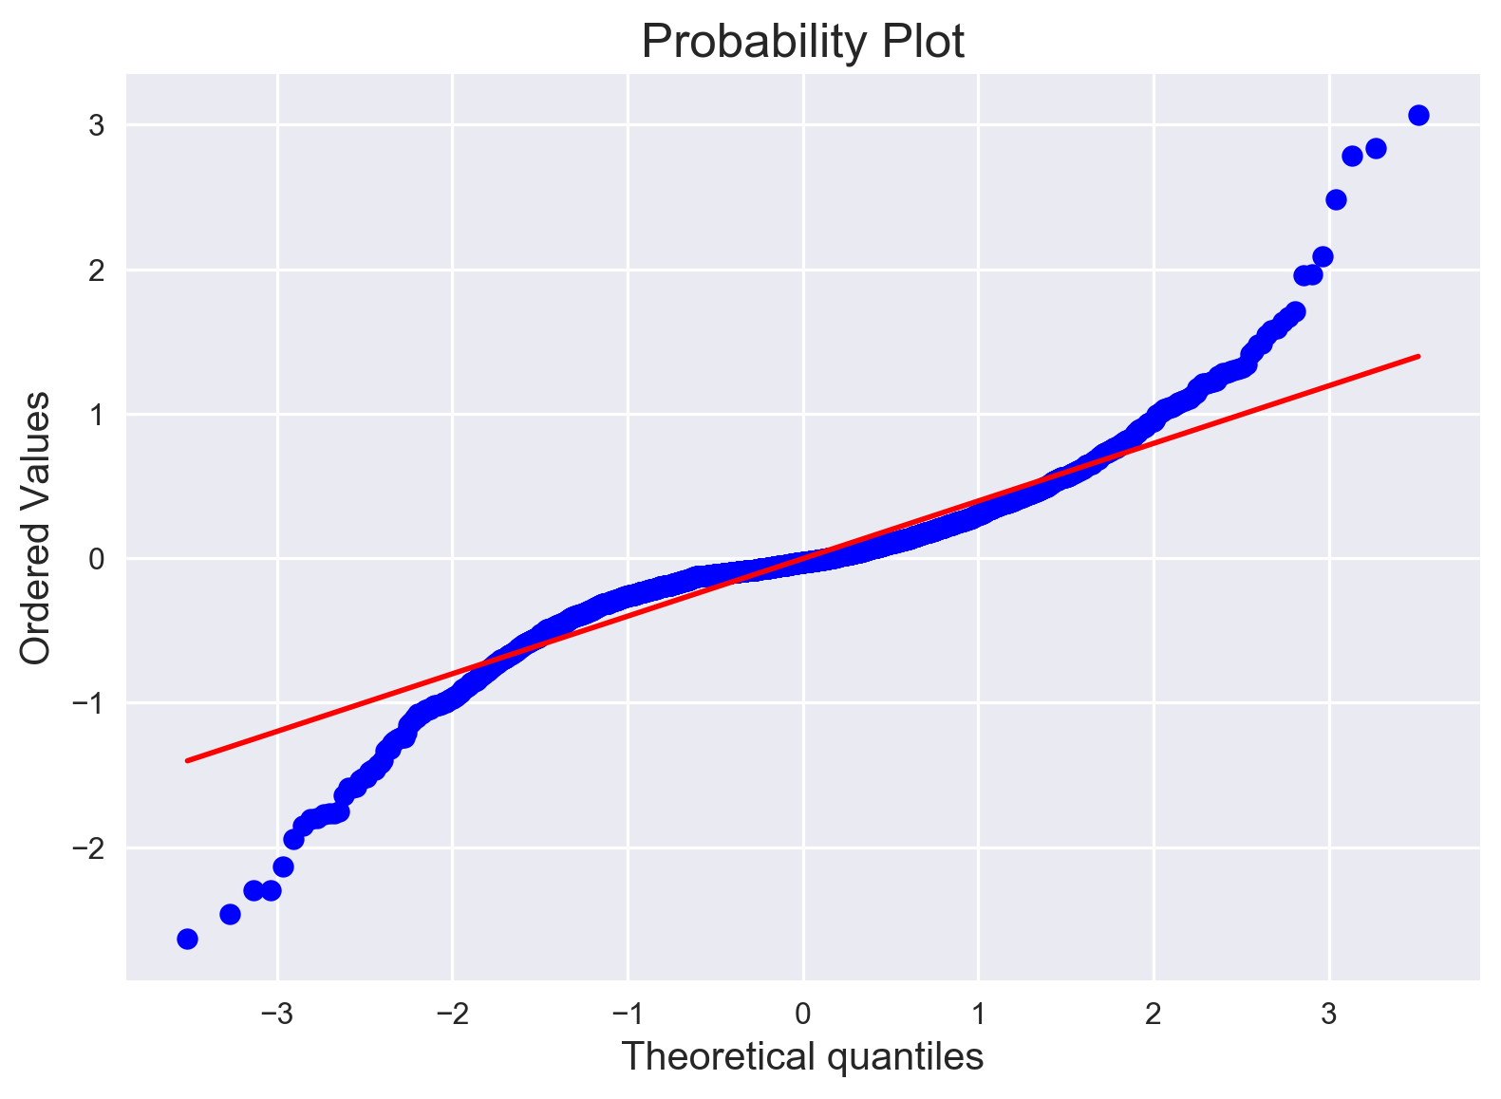

Slide 48
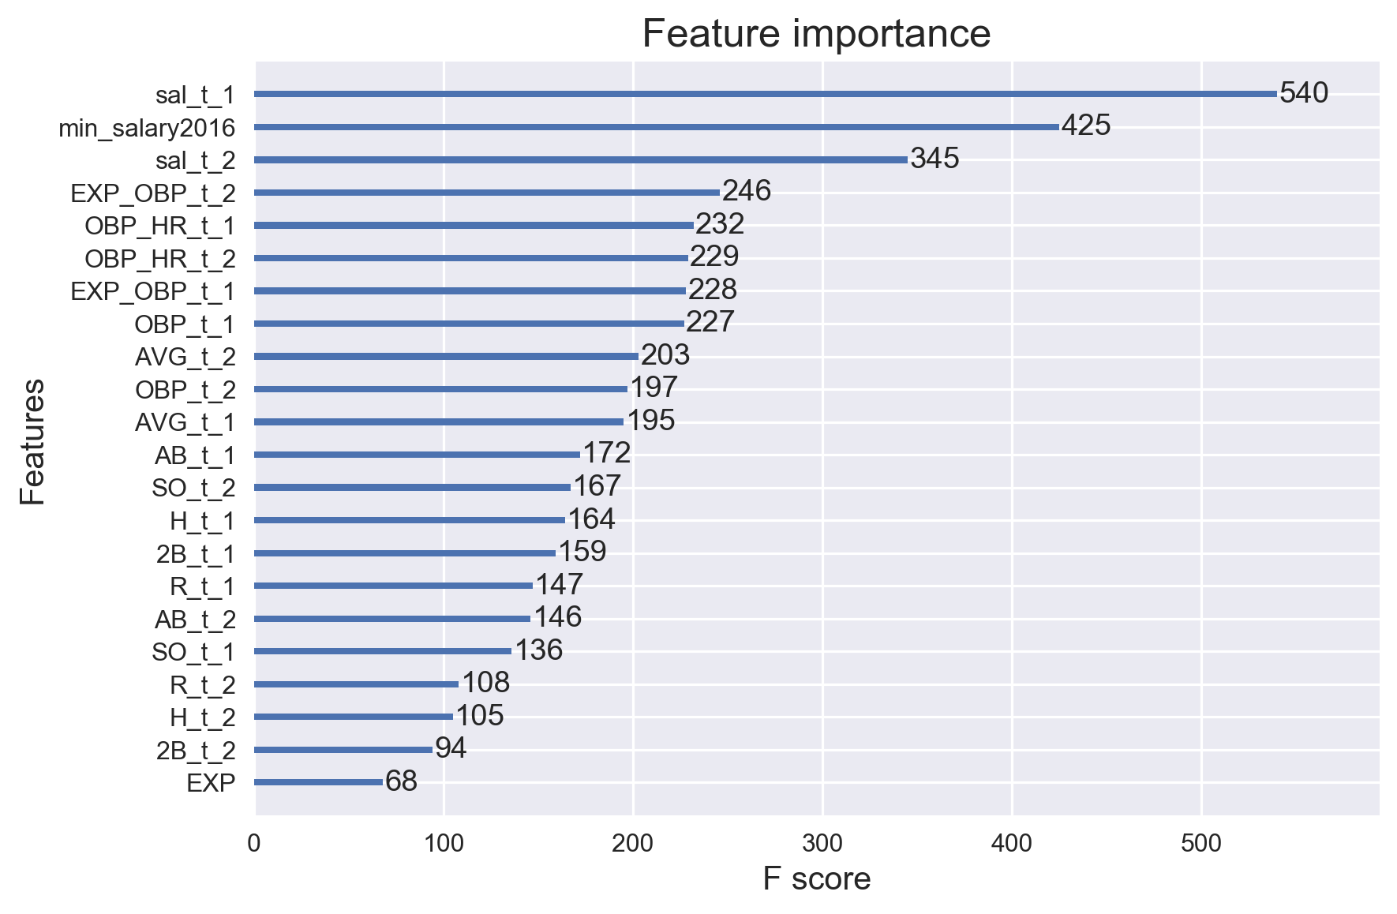

Slide 49
The most important predictors...

Slide 50
Lagged Salary
Current year minimum salary
Lagged interaction of experience and on-base %
Lagged Interaction of home runs and on-base %
Lagged on-base %
Lagged batting average

Slide 51
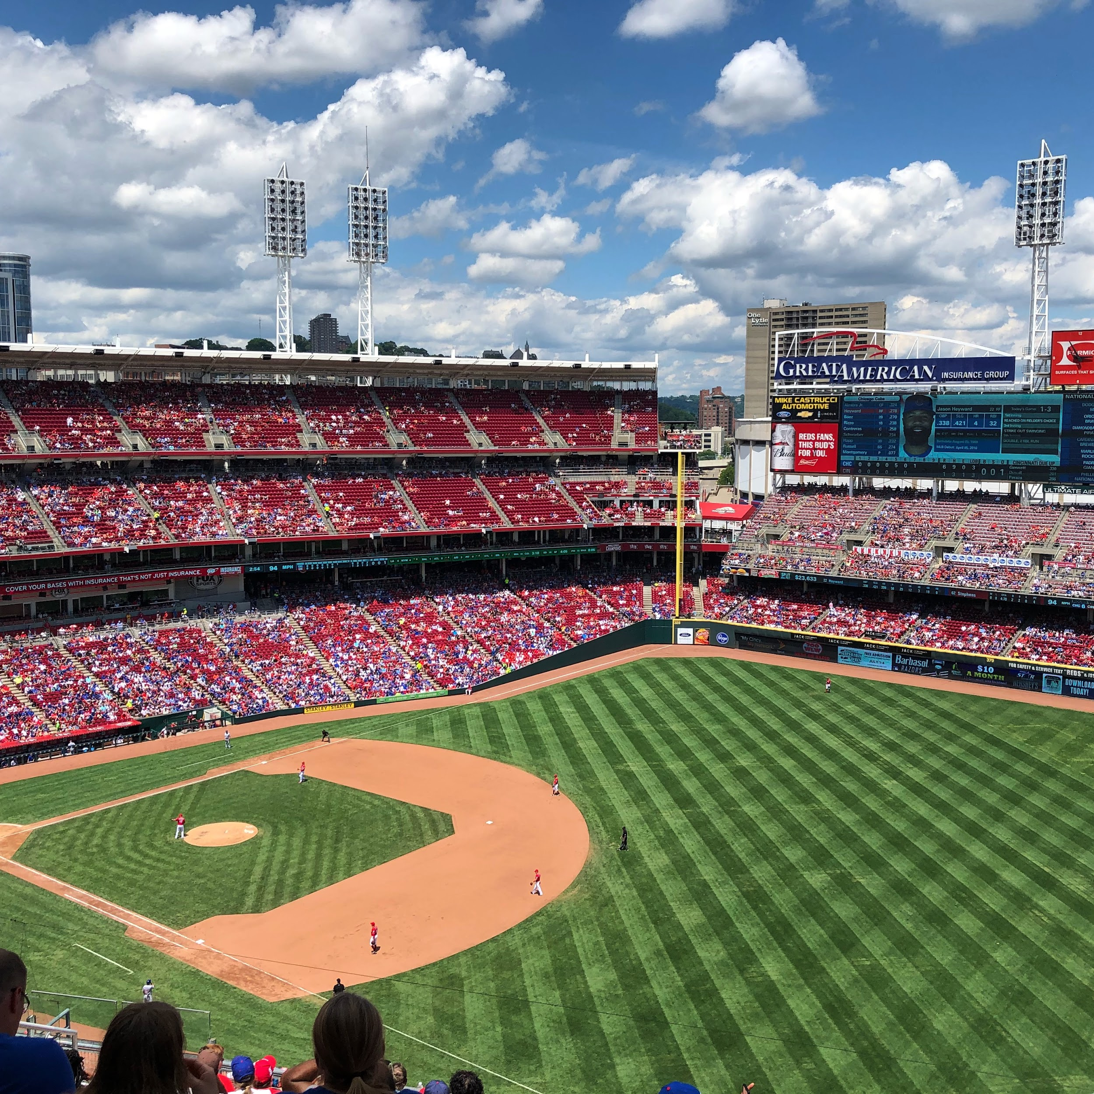
Thanks!
Contact me:
jeffreywhoffman@gmail.com

